Slide 2
Immanuel and Me With-Out Hyphen
By
Andre Gunder Frank
WELCOME
Presenter
Mr. Ajit Thapa
26 ^{th} December 2021 Sunday

Slide 3
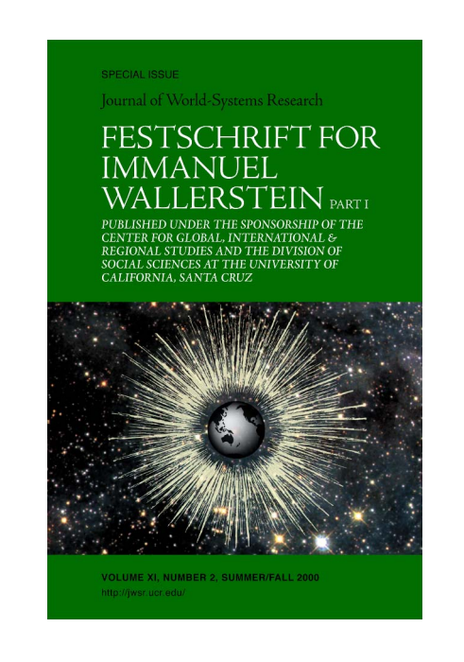
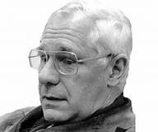
Immanuel and Me With-Out Hyphen
Andre Gunder Frank (February 24, 1929 – April 25, 2005) was a German - American sociologist and economic historian who promoted Dependency theory after 1970 and World system theory after 1984.
Andre Gunder Frank
Frank's undergraduate studies were at Swarthmore College , Pennsylvania USA from which he gained an Economics degree in 1950
Definition of Festschrift
A volume of writings by different authors presented as a tribute or memorial especially to a scholar
He earned his Ph.D. in Economics in 1957 at the University of Chicago
He was married to Marta Fuentes , with whom he wrote several studies about social movements, and with Marta he had two sons. second wife was sociologist Nancy Howell
Frank died in 2005 of complications related to his cancer while under the care of his third wife, Alison Candela

Slide 4
Andre Gunder Frank essay
My personal and intellectual tribute to Immanuel Wallerstein
Imagine our relations as a horizontal Y shaped rope.
It began with strands that, in the 1960s, ran parallel, becoming intertwined during the 1970s and 1980s until the strands (or at least some) separated again in the 1990s, going off in increasingly different directions like a horizontal Y. Why?
My account reflects my own perspective on this story. However it also includes other colleagues and friends of Immanuel’s and mine,
In particular our co-authors in several books and edited volumes, Giovanni Arrighi and Samir Amin, with whom I can check this account. Others, alas, are no longer with us.

Slide 5
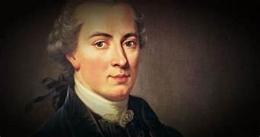
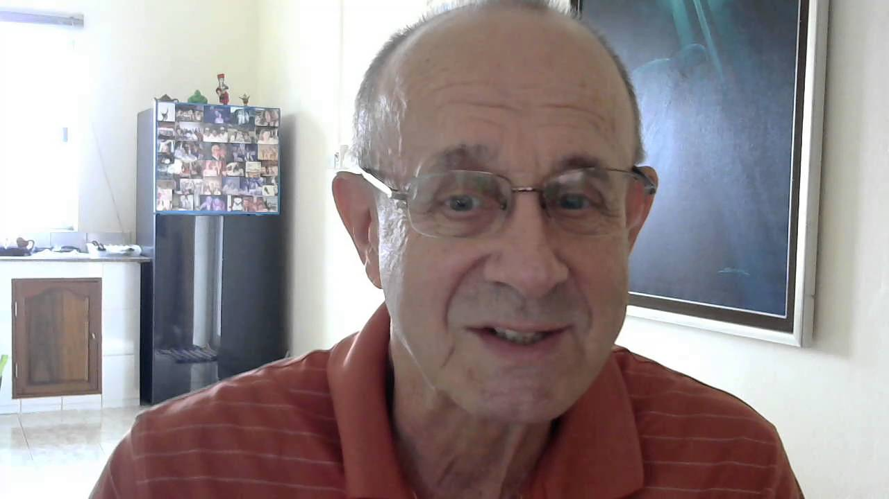
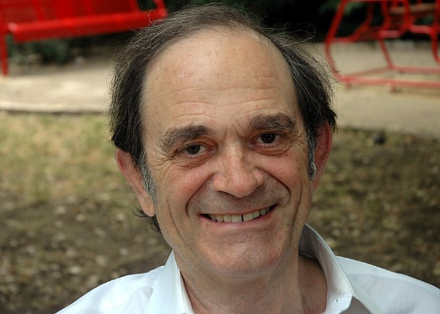
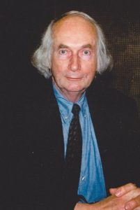
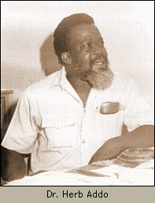
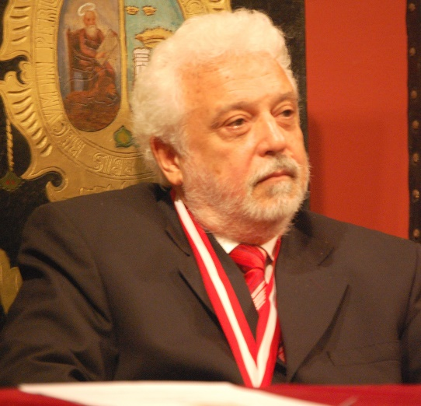
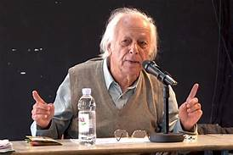
I. our parallel development in the 1960s
Significantly, all early world-systematisers previously worked in and on the ‘Third World,’ which led to our subsequent collaboration and friendship
My‘dependency’colleagues,like Theotonio dos Santos, and I of course worked in, and primarily on, Latin America

Slide 6
our parallel development in the 1960s……
Various parts of the Third Word are therefore unavoidable back ground and components of the development of the world-system [henceforth WS] perspective/approach/theory/analysis.
Indeed, in some cases the insistence on the WS capitalist structure/ accumulation/development/history whole world pie actually preceded the detailed analysis of African, Latin American, or Brazilian dependent slices of the pie.
In Latin America -an analysis of the ‘world system’ [without a hyphen] since the mid-1960s and in 1970 presented a 150 page paper on “the development of a theory and analysis adequate to encompass the structure and development of the capitalist system on an integrated worlds scale” to a conference in Lima.
Immanuel’s Modern World-System. Immanuel and I, working independently but parallel- World capitalist system-Europe between 1450 and 1500 and its spread from its West European to world

Slide 7
our parallel development in the 1960s……
One major difference between our books was that Immanuel’s much more scholarly and detailed one ended in 1640,
While my more superficial one went on to 1789, a period Immanuel would take up in his second volume.
Another major difference was Immanuel’s more detailed focus on the core/periphery/semi-periphery structure of the system,
As compared to my attempt to identify the cyclical (cyclic) dynamics of the system, especially how the recurrent long economic crises of capital accumulation modified the geographic extension and economic structure of the world capitalist system.

Slide 8
II. our common development in the 1970s and 1980s
In the 1970s and 1980s some of our work became intertwined, although our circumstances and styles remained very different.
We collaborated at conferences, co-authored books, and Immanuel published articles of mine in hi.s journal, Review, even after we started to disagree.
Our world-systemic historical interests.
The agreements and disagreements were knocked out in several hour-long meetings at Samir’s apartment in Paris.
Yes-or-no-smoking there and at dinner afterwards – conflict and became odd man out always.
First Book- “Dynamics of Global Crisis” The second one was Transforming the Revolution: Social Movements and the World-System
A very important question in all this, both theoretically and politically, was whether this world capitalist system[ic] crisis excludes or includes the ‘socialist’ countries- “inspiration” to edit Socialist States in the World-System,

Slide 9
III. our divergent development in the 1990s
Immanuel and I began to differ most—and increasingly so—on the prospects for the future: Immanuel always ends with the conclusion that for better or worse the present world capitalist system is doomed to be replaced by some other ‘system.’
Transforming the Revolution, and it coincided with the events at Tienanmen Square, China and the Berlin Wall, Germany. How much it was influenced by these events is hard to tell always.
Our divergence already had at least two identifiable experiences
in the 1980s.
1. One was that Joseph Needham had invited me to contribute to the planned Volume VII of his monumental “Science and Civilization in China” with a chapter on Why Europe and Not China made an industrial revolution. (Joseph Needham “The West, Capitalism, and the Modern World-System”)
2. The other originator of Immanuel’s and my growing divergence about world system history is that I was invited to comment on an early version of Janet Abu-Lughod’s work on the “13th century world system” that
later appeared as Before European Hegemony (1989).

Slide 10
Immanuel’s own clarification of a major issue between us:
Note a detail in word usage that distinguishes Frank and Gills from me.
They speak of a “world system.” I speak of “world-systems.” I use a hyphen; they do not.
I use the plural; they do not.
They use the singular because, for them, there is and has only been one world system through all of historical time and space.
For me there have been very many world-systems…. The modern world-system” (or the “capitalist world-economy”) is merely one system among many….That brings us to the hyphen.
My “world-system” is not a system “in the world” or “of the world.” It is a system “that is a world.”
Hence the hyphen, since “world” is not an attribute of the system. Rather the two words constitute a single concept. Frank and Gills’ s system is a World system in an attributive sense, in that it has been tending over time to cover the whole world
Gills’s and my response was that:
…the real debate/disagreement revolves around the question of what structure constitutes a “system” or a “World(-)system” in particular….
In our view, Amin and Wallerstein continue in the footsteps of Polanyi and Finley and underestimate the importance of capital accumulation via trade and market in the ancient world system….
The real dispute is over the character of the “international” or world system division of labor—not over its very existence….
Wallerstein stresses what in our view is only a particular modern phase in the development of this world system division of labor at a higher level of integration than may have generally prevailed earlier

Slide 11
three alternative paths to “Challenging Today’s Social Science Models”
(1) Total denial —as practiced by my friend Bob Brenner—that the received wisdom poses any problem whatsoever;
(2) Stretching old theory, such as social evolution and the logic of capitalism, to fit the new stretched history, as per Chase-Dunn and Hall and of course Immanuel and Samir
(3) Letting go of the old models altogether and beginning to build a new model of world-historical development

Slide 12
That is my goal in Reorient: “Global Economy in the Asian Age” where Immanuel and I really part company
I asked myself three related questions:
What are the implications for Braudel’s ‘European World-Economy’ and Immanuel’s capitalist ‘Modern World-System’ of my having argued that our single World System goes back at least five thousand, and not just five hundred, years?
What are the implications for the continuation of the world system since 1400 if Janet Abu-Lughod’s “13th Century World System” was a step in the development of that same system, so that it did not break down in 1350 as she argued, and was not reborn in Europe in 1450 as Immanuel still insists?
(3) What is to be done both historically/empirically and theoretically/analytically if the Braudel/ Wallerstein models of a European world-economy and capitalist modern world-system are unsatisfactory, as I argued in my “Re-reading” of them in Sanderson ed. (1995)?

Slide 13
Summery
The moral of the story is therefore;
1. The outstanding question of theory and praxis ( Practice) is not what to do in or about a world that was not born in or by Europe, as has been mistakenly alleged ( suspected) by everybody from Marx and Weber to Braudel and Immanuel.
2. The question is instead how to Reorient our historiography and social theory, to take account not only of the “Global Economy in the Asian Age” before the year 1800 but probably also after the year 2000 (Frank 1998).
3. It is strange, and for me sad, that after so long a road traveled together Immanuel’s and my paths should now diverge on that account. All the more so since, to close my personal and theoretical tribute to him, I can do no better than to quote Immanuel himself where we still agree:
The expectation of universality, however sincerely pursued, has not been fulfilled thus far in the historical development of the social sciences…. It is hardly surprising that the social sciences that were constructed in Europe and North America in the 19th century were Eurocentric.
World of the time felt itself culturally victorious…. Every universalism sets off responses to itself, and these responses are in some sense determined by the nature of the reigning universalism(s)…. Submitting our theoretical premises to inspection for hidden unjustified a priori assumptions is a priority for the social sciences today.

Slide 14
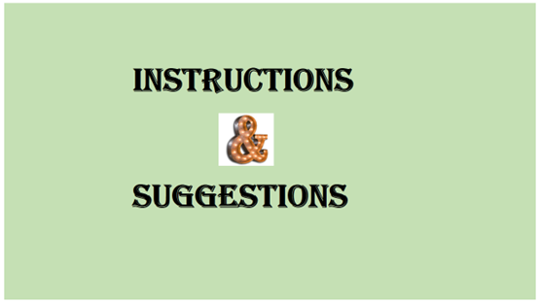
Class 1. “The continuity thesis on world development”
– Sunday 2nd January 2022 (Mr. Anish Adhikari and team ; 3 more members )
Class 2.– “World System : Simileritie and differences “
-Sunday 9th January 2022 (Mr. Hari Koirala and team; 3 more members )

